Slide 1


Automatic Speech Recognition
Identification of Risk for Hospitalizations and Emergency Department Visits in Home Healthcare
Team 9 • Fall 2025
Presented by: Rashmi and Ameerkhan
Instructor: Dr. Kewei Isaac Li

Slide 2

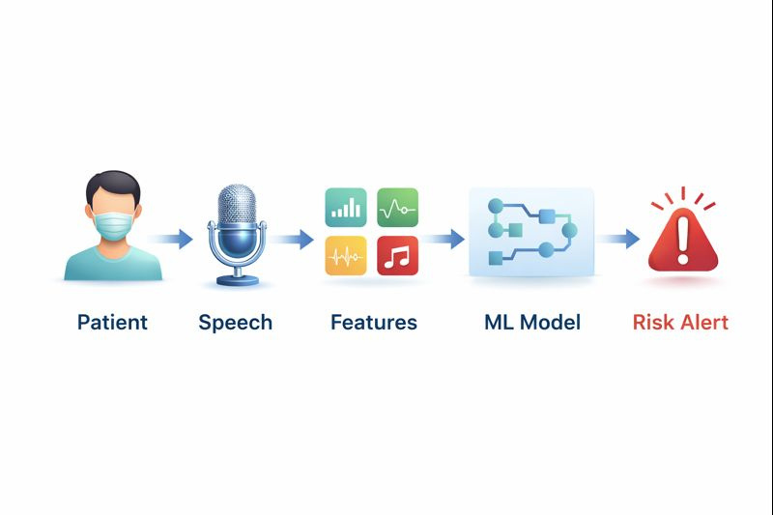
Problem & Motivation
  Home healthcare patients deteriorate between nurse visits
  Subtle symptoms often go undetected
  Speech contains acoustic biomarkers of illness
  Need for non-invasive, scalable monitoring

Slide 3
Project Objectives
  Data Integration: Merge Coswara audio and metadata into unified labeled dataset.
  Feature Engineering: Extract 46 acoustic features (MFCC, spectral, prosodic).
  Model Development: Train XGBoost classifiers for healthy vs. positive/at-risk.
  Evaluation: Assess with accuracy, precision, recall, F1, AUC; prioritize minority-class detection.

Slide 4
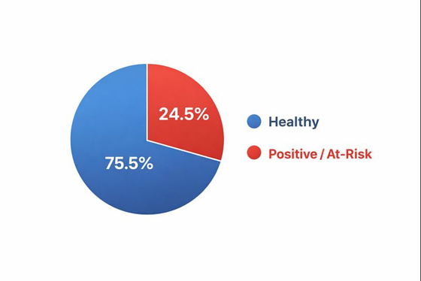
Dataset Overview
Dataset Stats
Audio Types
  Total samples: 2,374
  Usable samples: 2,273
  Healthy: 1,794
  Positive/At-Risk: 479
  Class imbalance: 3.75 : 1
• Heavy cough recordings
• Deep breathing sounds
• Sustained vowels (/aaa/)
• Short speech utterances

Slide 5
Problem Formulation
Target Labels
Label 0 – Healthy
  healthy
  recovered_full
  no_resp_illness_exposed
Label 1 – Positive / At-Risk
  positive_mild
  positive_asymptomatic
  positive_moderate
Train/Test Split
Training: 1,818 samples (80%)
78.7% healthy, 21.3% positive
Test: 455 samples (20%)
Stratified split preserves class proportions

Slide 6
Audio Preprocessing
  Preprocessing: Resample to 16 kHz, normalize loudness, trim silence with VAD.
  Features (46 total):
  MFCCs: 13 coefficients + delta + delta-delta (39 dims)
  Spectral: centroid, bandwidth, rolloff, zero-crossing rate
  Additional: chroma, tempogram features capturing pitch and rhythm

Slide 7
Modeling Stratergy
  Baseline: XGBoost with default hyperparameters on 46 standardized features.
  Evaluation Metrics: Accuracy, precision, recall, F1, AUC—prioritizing positive-class recall.
  Hyperparameter Tuning: Randomized search + 4-fold stratified CV.
  Selection Criterion: Mean CV AUC (minority-class detection over raw accuracy).

Slide 8
Baseline Model Performance
Target Improvements
  Positive Recall: 0.50–0.65 (vs 0.42 baseline)
  AUC: 0.72–0.76 (vs 0.70 baseline)
  Accept minor accuracy decrease for clinical relevance
  Class-wise Metrics
Healthy: Precision 0.82, Recall 0.95
  Positive: Precision 0.67, Recall 0.55

Slide 9
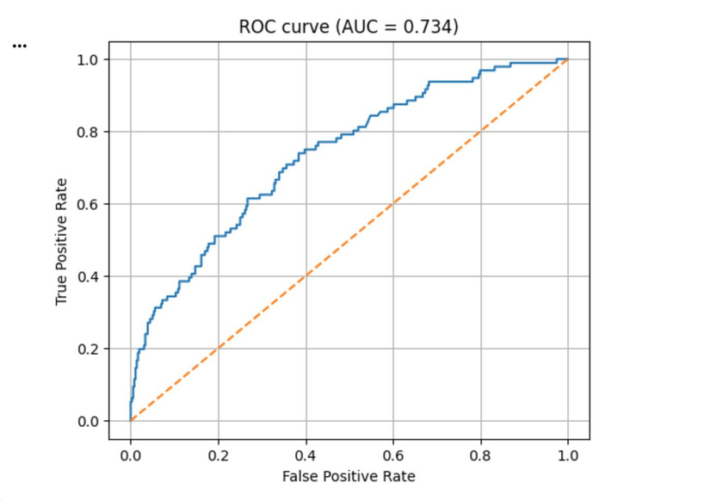
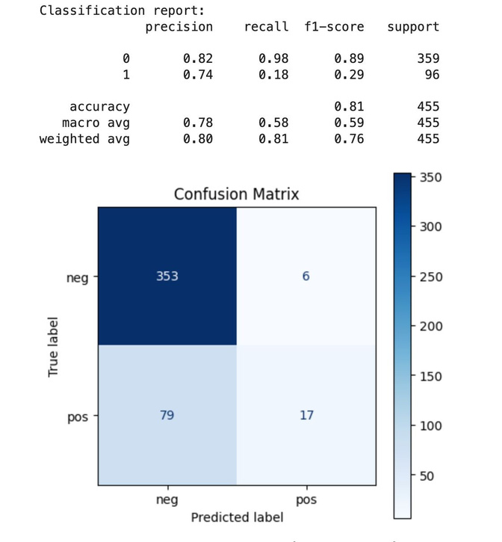
Model Performance
‹#›

Slide 10
Clinical Applicability & Future Work
Home Healthcare Integration:
  Passive voice collection via smartphone app between nurse visits.
  Automated alerts for subtle deterioration signals.
  Future Work:
  Validate on independent datasets add linguistic features and multi-task learning.
  Longitudinal studies tracking acoustic changes within individuals over time.
‹#›

Slide 11

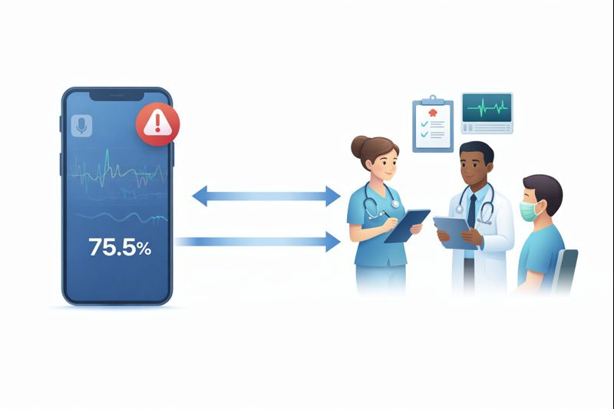
Conclusion
  Built a complete pipeline: Coswara integration, 46-feature acoustic representation, XGBoost tuning.
  Baseline: 81% accuracy, AUC 0.73 tuning targets 50–65% positive recall for clinical relevance.
  Demonstrates the feasibility of speech-based health screening and motivates multimodal extensions.
Notes:
16

Slide 12

Questions
18

